Slide 1
Managing Credit Risk

Slide 2
Managing
Meaning of Credit risk
Impact of Credit Default
Sources of data for Managing Risk
Understanding Loss Given default – LGD
Understanding Default

Slide 3
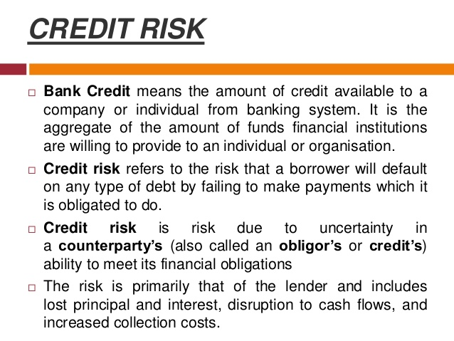

Slide 4
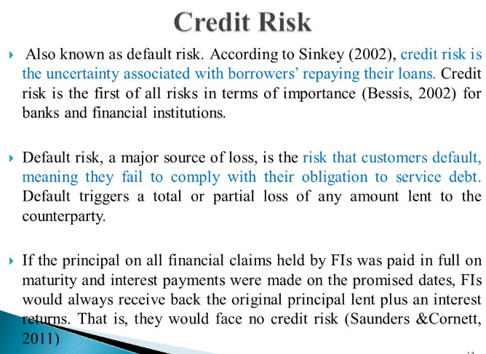

Slide 5
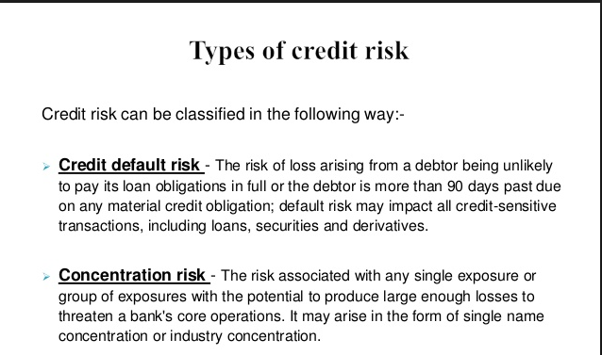

Slide 6
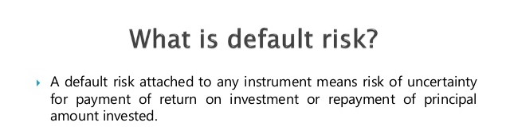

Slide 7
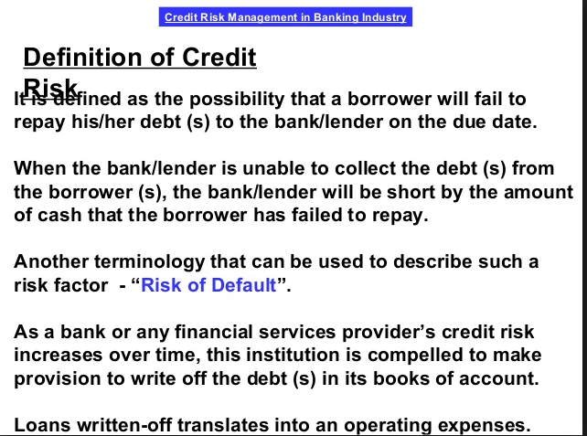

Slide 8
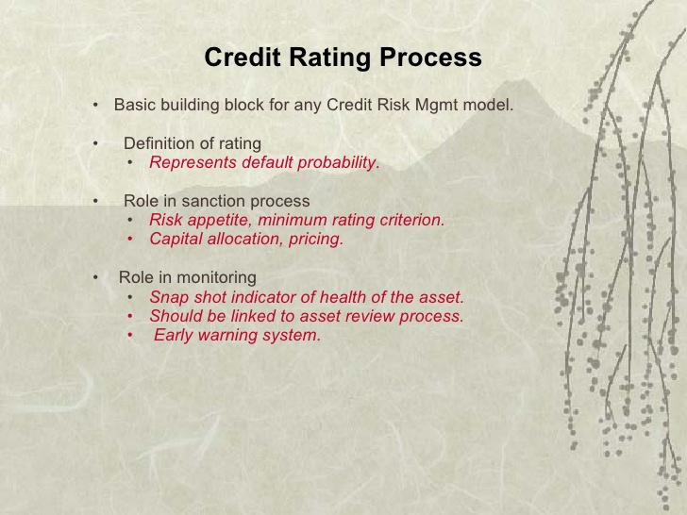

Slide 9
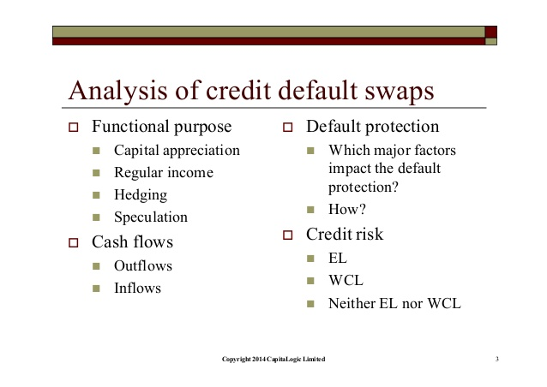
Impact of Credit Default

Slide 10
sources of data for managing risk
Banks and other financial services companies
Customers and suppliers
Credit analysis is the method by which one calculates the creditworthiness of a business or organization.

Slide 11
Standard & Poor's,
Moody's
Basel Committee

Slide 12
Standard & Poor's Financial Services LLC (S&P) is an American financial services company.

Slide 13
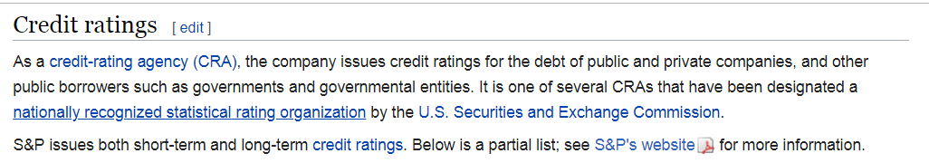

Slide 14
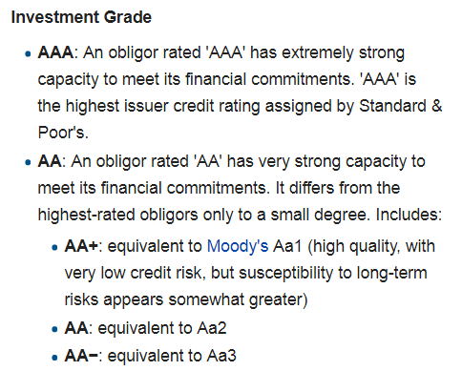

Slide 15
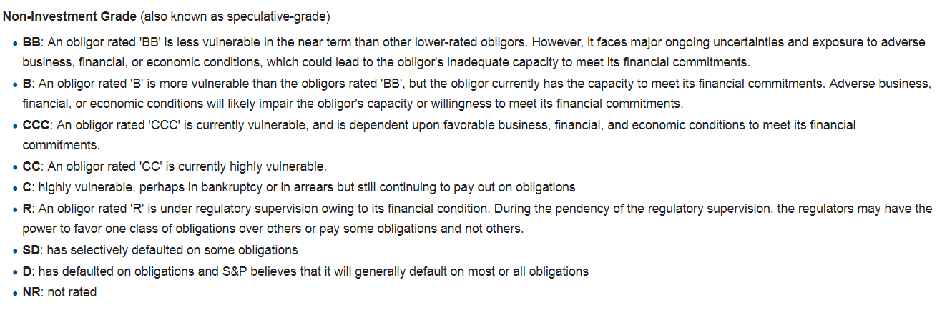

Slide 16
Short-term issue credit ratings

Slide 17
Moody's Investors Service, often referred to as Moody's, is the bond credit rating business of Moody's Corporation
The company ranks the creditworthiness of borrowers using a standardized ratings scale which measures expected investor loss in the event of default.

Slide 18
Moody securities are assigned a rating from Aaa to C, with Aaa being the highest quality and C the lowest quality.

Slide 19
Fitch Group

Slide 20
CRISIL (formerly Credit Rating Information Services of India Limited) - S&P Global
S&P Global - Capital IQ

Slide 21
Loss Given Default
What is 'Loss Given Default - LGD'
Loss given default (LGD) is the amount of money a bank or other financial institution loses when a borrower defaults on a loan

Slide 22
For example, consider that Bank A loans $2 million to Company XYZ, and the company defaults. Bank A’s loss is not necessarily $2 million. Other factors must be considered, such as the amount of assets the bank may hold as collateral and whether the bank makes use of the court system for reparations from Company XYZ. With these and other factors considered, Bank A may, in reality, have sustained a far smaller loss than the initial $2 million loan.

Slide 23
The Basel Model
Determining the amount of loss is an important and fairly common parameter in most risk models.
LGD is an essential piece of the Basel Model (Basel II) as it is used in the calculation of economic capital, expected loss, or regulatory capital.
LGD is most closely tied to
expected loss, which is the resulting product of
LGD,
probability of default (PD), and
exposure at default (EAD).

Slide 24
What is a 'Default Probability'
Default probability is the likelihood over a specified period, usually one year, that a borrower will not be able to make scheduled repayments. Default probability, or probability of default (PD), depends not only on the borrower's characteristics but also on the economic environment.

Slide 25
IMPT !!
Generally, the higher the default probability, the higher the interest rate the lender will charge the borrower.
Creditors typically want a higher interest rate to compensate for bearing higher default risk.

Slide 26
Default model
Default model is constructed by financial institutions to determine the likelihood of a default on credit obligations by a corporation or sovereign entity.
These statistical models often use regression analysis with certain market variables that are pertinent to a company's financial situation to identify the nature and scope of credit risk.

Slide 27
Exposure at Default (EAD)
Exposure at default (EAD) is the total value a bank is exposed to when a loan defaults.
There are two methods to determine exposure at default. Regulators use the first approach, which is called foundation internal ratings-based (F-IRB). The second method, called advanced internal ratings-based (A-IRB), is more flexible and is used by the banking institutions

Slide 28
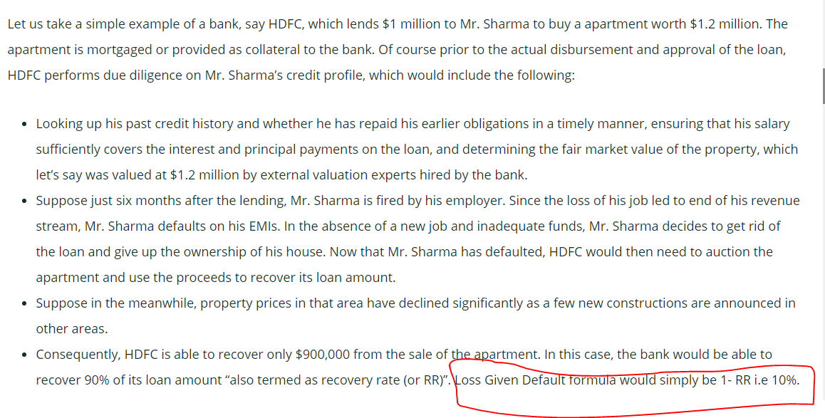

Slide 29
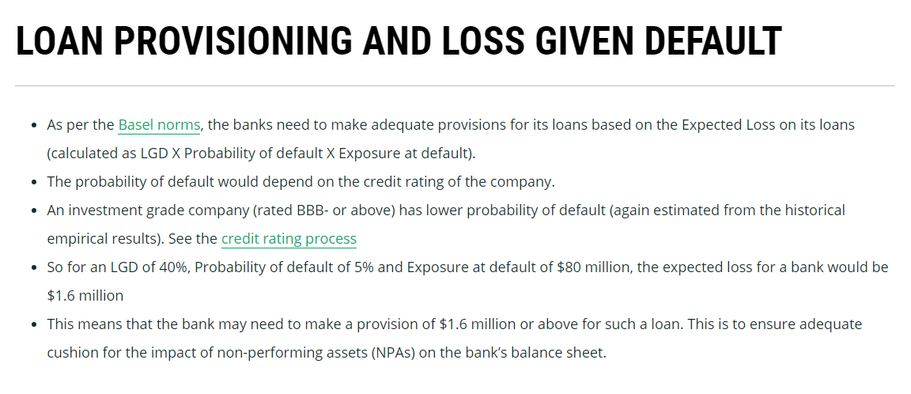
LOSS GIVEN DEFAULT – KINGFISHER AIRLINE EXAMPLE

Slide 30
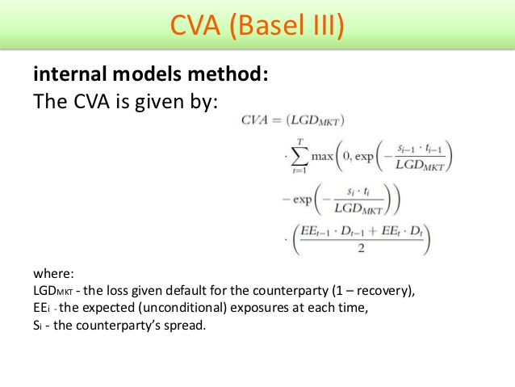
counterparty

Slide 31
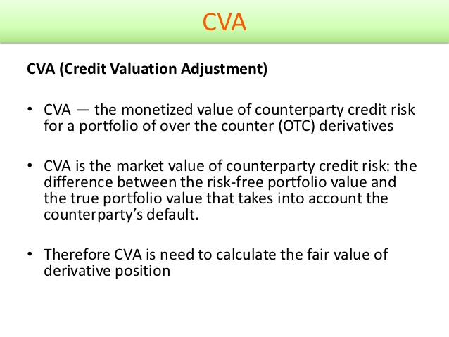

Slide 32
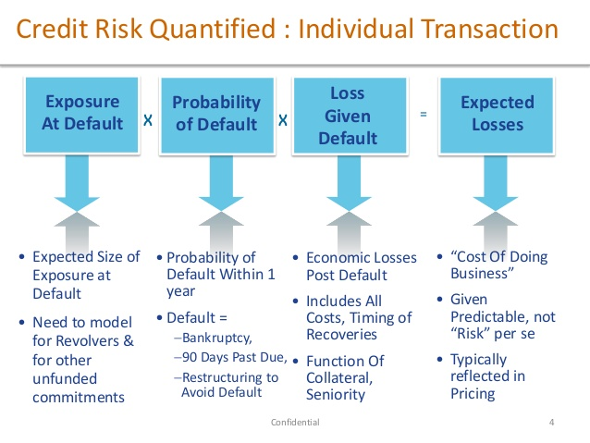

Slide 33
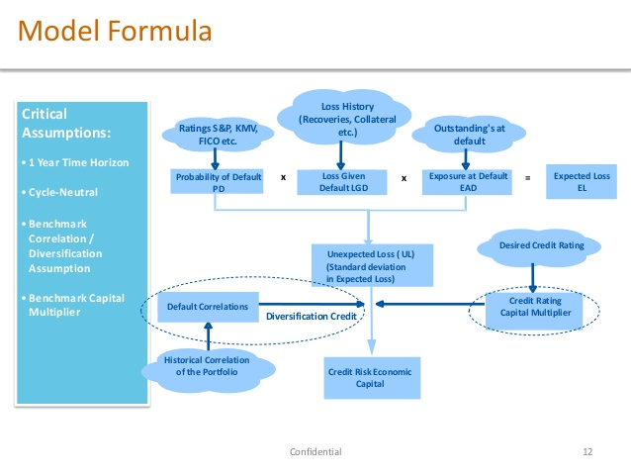

Slide 34
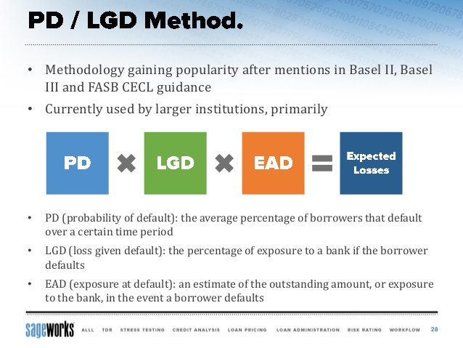

Slide 35
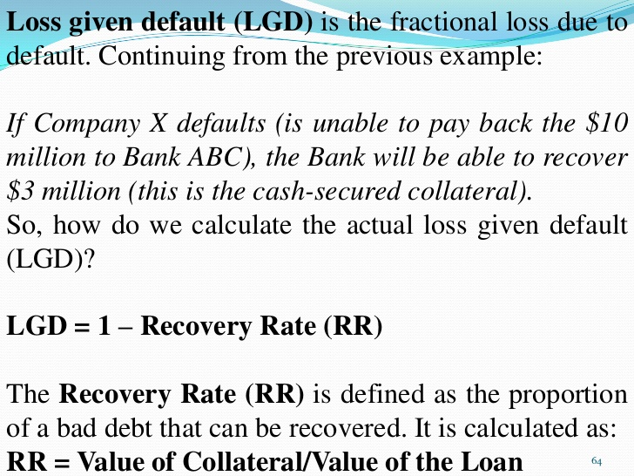

Slide 36
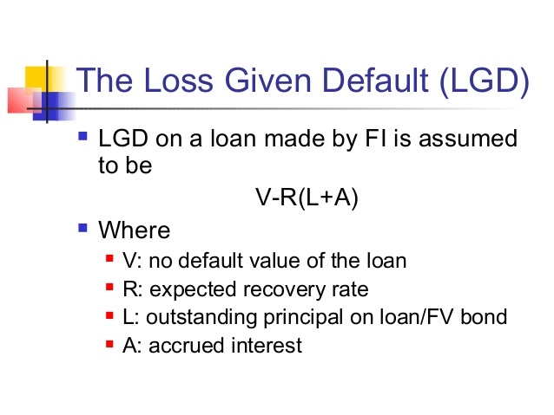

Slide 37
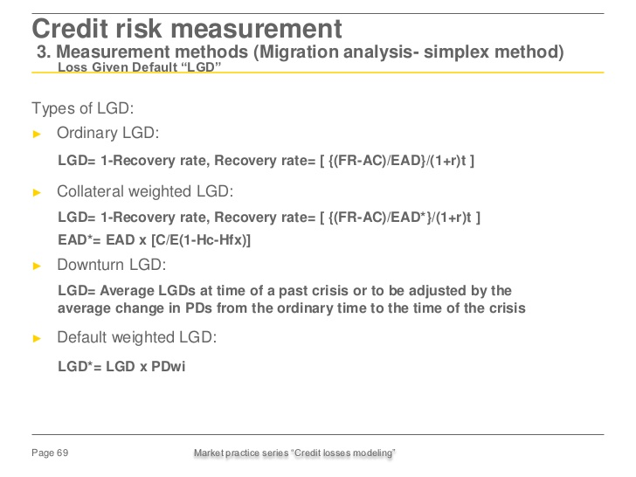

Slide 38
Understanding Default

Slide 39
The LGD calculation is easily understood with the help of an example:
If the client defaults with an outstanding debt of $200,000 and
the bank or insurance is able to sell the security (e.g. a condo) for a net price of $160,000 (including costs related to the repurchase),
then the LGD is 20% (= $40,000 / $200,000).

Slide 40
Exposure without Collateral
Exposure with Collatera

